Slide 1
DNS
Domain Name System
By Ilian Trifonov

Slide 2
Why use names instead of IP numbers
IP Addresses are hard to remember for humans
IP Addresses can change
Network only understands numeric addresses
Solution:
Use alphanumeric names to refer to hosts
Add a distributed hierarchical protocol (DNS) to map between alphanumeric host names and IP addresses

Slide 3
Originally everything was located in ‘hosts’ files:
127.0.0.1 localhost
192.168.0.174 store1
192.168.0.238 store2
192.168.0.244 store3
192.168.155.2 operations
8.8.8.8 ns.google.com
89.25.120.31 google.com
89.25.120.24 www.google.com
Linux: /etc/hosts
Windows: C:\Windows\System32\drivers\etc\hosts
Originally a file on a shared drive had to be copied each day. After too many computers came onto the network, DNS was created
You can still override or add these kinds of mappings to the same files today

Slide 4
What is DNS?
Internet Directory Service
A protocol that maps host names to corresponding IP addresses
Mapping host names into their IP addresses is called name resolution, name translation, name mapping or address resolution.

Slide 5
DNS
Internet Corporation For Assigned Names and Numbers
IANA is now part of it
Handles ccTLDs
Handles gTLDs
Handles the Root zone
Country level domains
.bg, .co.za, .co.uk, .edu.us
Top-level domains
.com, .net, .org, .edu, .gov, .mil
.biz, .name, .info

Slide 6
Domain name registrar
A domain name registrar is an organization or commercial entity that manages the reservation of Internet domain names. A domain name registrar must be accredited by a generic top-level domain (gTLD) registry and/or a country code top-level domain (ccTLD) registry. The management is done in accordance with the guidelines of the designated domain name registries.

Slide 7
DNS Root Servers
13 server IP numbers
This does not mean that there are only 13 physical servers; each operator uses redundant computer equipment to provide reliable service even if failure of hardware or software occurs. Additionally, all (except B-Root) operate in multiple geographical locations using a routing technique called anycast addressing, providing increased performance and even more fault tolerance
Logical names in the form letter.root-servers.net, where letter ranges from a to m

Slide 8
Root zone file
The root zone file is a small (about 2MB) data set whose publication is the primary purpose of root name servers
The root zone file is at the apex of a hierarchical distributed database called the Domain Name System (DNS). This database is used by almost all Internet applications to translate worldwide unique names like www.wikipedia.org into other identifiers such as IP addresses.
The contents of the root zone file is a list of names and numeric IP addresses of the authoritative DNS servers for all top-level domains (TLDs) such as com, org, edu, or the country code top-level domains. As of July 2015, there were 1058 TLDs. On 12 December 2004, 773 different authoritative servers for those TLDs listed
Other name servers forward queries for which they do not have any information about authoritative servers to a root name server. The root name server, using its root zone file, answers with a referral to the authoritative servers for the appropriate TLD or with an indication that no such TLD exists

Slide 9
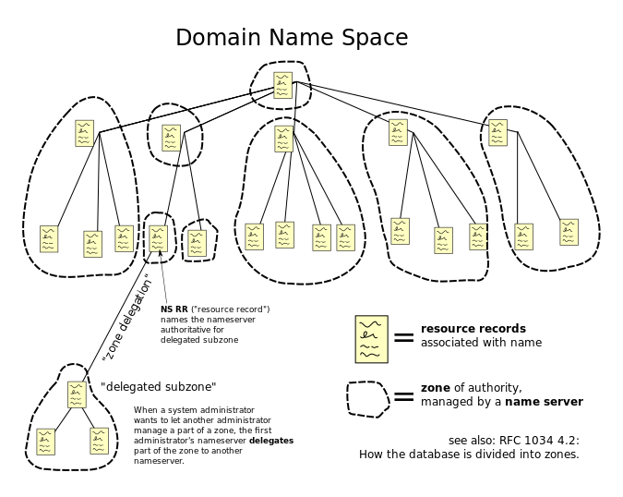

Slide 10
DNS Servers
Root zone servers – Have information on where authoritative name servers are located (their IP addresses) for the particular top level domain (.net, .com, .bg)
Authoritative name servers - nameserver (DNS Server) that holds the actual DNS records (A, AAAA, CNAME, PTR, etc) for a particular domain/ address. A recursive resolver would be a DNS server that queries an authoritative nameserver to resolve a domain/ address

Slide 11
DNS Servers
Recursive name server - they perform every step necessary to answer any DNS query they receive. To do this the name server queries each authoritative name-server in turn, starting from the DNS root zone. It continues until it reaches the authoritative server for the zone that contains the queried domain name. That server provides the answer to the question, or definitively says it can't be answered
Caching name server – so called DNS caches store DNS query results for a period of time determined in the configuration (time-to-live) of each domain-name record. DNS caches improve the efficiency of the DNS by reducing DNS traffic across the Internet, and by reducing load on authoritative name-servers, particularly root name-servers. Caching name servers are often also recursive name servers.
The authority, resolving and caching functions can all be present in a DNS server implementation, but this is not required: a DNS server can implement any one of these functions alone, without implementing the others. Internet service providers typically provide caching resolvers for their customers. In addition, many home-networking routers implement caching resolvers to improve efficiency in the local network

Slide 12
DNS Resolvers
The client side of the DNS is called a DNS resolver. A resolver is responsible for initiating and sequencing the queries that ultimately lead to a full resolution (translation) of the resource sought, e.g., translation of a domain name into an IP address. An individual DNS query may be either non-recursive, recursive, or iterative, or a combination of these

Slide 13
DNS Query
For the non-recursive query method, a DNS resolver client queries a DNS server that provides a record for a domain for which it is authoritative itself, or it provides a partial result without querying other servers. In case of a caching DNS resolver, the non-recursive query of its local DNS cache delivers a result and reduces the load on upstream DNS servers by caching DNS request records for a period of time after an initial response from upstream DNS servers
For the recursive query approach, a DNS resolver client will query a single DNS server, which may then query (as a client itself) other DNS servers on behalf of the requester. For example, a simple "stub resolver" running on a home router will typically make a recursive query to the DNS server run by the user's ISP. A recursive query is one for which the DNS server will fully answer the query (or give an error) by querying other name servers as needed. In typical operation, a client will issue a recursive query to a caching recursive DNS server, which will then issue non-recursive queries to determine the answer and send a single answer back to the client. The resolver, or another DNS server acting recursively on behalf of the resolver, negotiates use of recursive service using bits in the query headers. DNS servers are not required to support recursive queries
For the iterative query procedure, a DNS resolver client will query a chain of one or more DNS servers. Each server will refer the client to the next server in the chain, until the current server can fully resolve the request. For example, a possible resolution of www.example.com would query a global root, then a .com server, and finally .example.com

Slide 14
Root name server
Local Cache
Browser
DNS Resolver
Home Router
TLD Address
(iterative query)
Mail Client
DNS Resolver
Root zone file
Recursive query
Client programs
Operating System
Local Cache
TLD name server
Computer/Phone/Tablet etc
RR (resource records)
Recursive query
RR, or Authoritative name server address
(iterative query)
Authoritative server IP
ISP
Recursive name server
Authoritative name server
DNS Resolver
Local Cache
RR (resource record)
(iterative query)
RR (resource records)

Slide 15
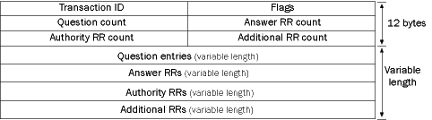
DNS protocol

Slide 16
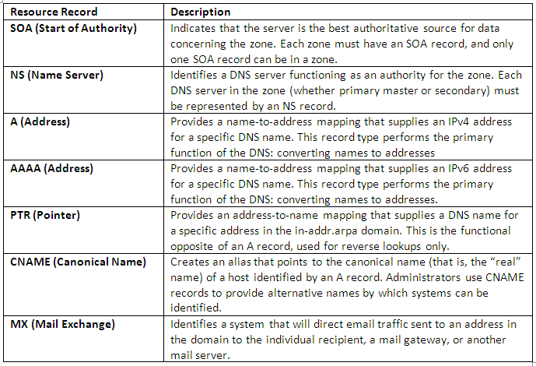
DNS Record

Slide 17
Reverse DNS lookup
A reverse lookup is a query of the DNS for domain names when the IP address is known. Multiple domain names may be associated with an IP address. The DNS stores IP addresses in the form of domain names as specially formatted names in pointer (PTR) records within the infrastructure top-level domain arpa. For IPv4, the domain is in-addr.arpa. For IPv6, the reverse lookup domain is ip6.arpa. The IP address is represented as a name in reverse-ordered octet representation for IPv4, and reverse-ordered nibble representation for IPv6
When performing a reverse lookup, the DNS client converts the address into these formats before querying the name for a PTR record following the delegation chain as for any DNS query. For example, assuming the IPv4 address 208.80.152.2 is assigned to Wikimedia, it is represented as a DNS name in reverse order: 2.152.80.208.in-addr.arpa. When the DNS resolver gets a pointer (PTR) request, it begins by querying the root servers, which point to the servers of American Registry for Internet Numbers (ARIN) for the 208.in-addr.arpa zone. ARIN's servers delegate 152.80.208.in-addr.arpa to Wikimedia to which the resolver sends another query for 2.152.80.208.in-addr.arpa, which results in an authoritative response.
These requests are done for security reasons

Slide 18
DNS cache poisoning
DNS spoofing, also referred to as DNS cache poisoning, is a form of computer security hacking in which corrupt Domain Name System data is introduced into the DNS resolver's cache, causing the name server to return an incorrect IP address. This results in traffic being diverted to the attacker's computer (or any other computer)
To perform a cache poisoning attack, the attacker exploits flaws in the DNS software. A server should correctly validate DNS responses to ensure that they are from an authoritative source (for example by using DNSSEC); otherwise the server might end up caching the incorrect entries locally and serve them to other users that make the same request
This attack can be used to redirect users from a website to another site of the attacker's choosing. For example, an attacker spoofs the IP address DNS entries for a target website on a given DNS server and replaces them with the IP address of a server under their control. The attacker then creates files on the server under their control with names matching those on the target server. These files usually contain malicious content, such as computer worms or viruses. A user whose computer has referenced the poisoned DNS server gets tricked into accepting content coming from a non-authentic server and unknowingly downloads the malicious content.

Slide 19
Additional resources for DNS
https://www.youtube.com/watch?v=72snZctFFtA
https://www.youtube.com/watch?v=Rck3BALhI5c
https://www.youtube.com/watch?v=pkvaTUl5F-Y

Slide 20
Demo
Wireshark + nslookup

Slide 21
Questions?

